Slide 1

AICTE • EDUSKILLS • NATIONAL INTERNSHIP PORTAL
INTERNSHIP REPORT
IoT Cloud Engineer
Virtual Internship
An 8-week virtual internship on cloud-enabled IoT engineering, with curriculum delivered through AWS Skill Builder under the AICTE–EduSkills National Internship Programme.
GREATER NOIDA
Department of Computer Science
& Engineering
STUDENT NAME
ENROLLMENT NUMBER
Yash Tyagi
2410030590
PROGRAM & SEMESTER
B.Tech CSE — 5th Semester
June – August 2026

Slide 2

CONTENTS
What This Report Covers
01
About the Internship Programme
06
Hands-on Project Work
02
Program Partners & Platform
07
Skills Gained
03
Internship Timeline & Process
08
Certification & Outcomes
04
Curriculum Modules Covered
09
Key Learnings & Conclusion
05
Core Technologies & AWS Services
IILM UNIVERSITY, GREATER NOIDA
02

Slide 3
PROGRAMME OVERVIEW
About the Internship
The IoT Cloud Engineer Virtual Internship is a National Internship Portal initiative run by AICTE in partnership with EduSkills, with technical curriculum delivered through AWS Skill Builder. The programme introduces students to cloud-enabled Internet of Things (IoT) engineering — connecting devices, moving their data into the cloud, and building secure, scalable services on top of it. It combines structured e-learning, hands-on labs, and a guided capstone project completed under faculty supervision.
8 wks
Programme Duration
100%
Virtual / Remote Mode
1
Guided Capstone Project
It is designed to help engineering students bridge classroom concepts with the practical, industry-aligned skills expected of a cloud-facing IoT engineer.
Grade O
Outstanding Performance
IILM UNIVERSITY, GREATER NOIDA
03

Slide 4



WHO MADE IT POSSIBLE
Programme Partners
AICTE
EduSkills Foundation
AWS Skill Builder
All India Council for Technical Education administers the programme nationally through the National Internship Portal, and co-issues the final internship certificate.
EduSkills coordinates enrollment, mentoring sessions, faculty guidance, and project evaluation across participating institutions.
AWS Skill Builder supplies the technical curriculum — structured courses, hands-on labs, and assessments covering cloud and IoT concepts.
Together, these partners connect national policy, mentorship, and industry-grade cloud training into a single guided internship experience.
IILM UNIVERSITY, GREATER NOIDA
04

Slide 5
HOW IT UNFOLDED
Internship Timeline
Registration
Course Modules
Capstone Project
Applied via the AICTE National Internship Portal and the EduSkills portal.
Completed structured cloud & IoT modules with online assessments.
Built and submitted a guided IoT-cloud project.
1
2
3
4
5
6
Enrollment
Mentoring Sessions
Certification
Shortlisted and enrolled on the AWS Skill Builder learning platform.
Attended guided sessions with industry mentors and faculty.
Awarded the AICTE–EduSkills Internship Certificate, Grade O.
IILM UNIVERSITY, GREATER NOIDA
05

Slide 6







CURRICULUM
Modules Covered
Cloud Computing Fundamentals
Introduction to IoT Systems
AWS IoT Core & Device Management
Data Ingestion & Analytics
Cloud Storage & Databases
Networking & Cloud Security
Architecting IoT-Cloud Solutions
Capstone Project & Evaluation
IILM UNIVERSITY, GREATER NOIDA
06

Slide 7





TOOLS & PLATFORM
Core Technologies & AWS Services Explored
AWS IoT Core
Amazon EC2
Amazon S3
Connecting and managing simulated IoT devices securely.
Provisioning virtual compute instances for backend services.
Storing device data and static application assets.
AWS Lambda
Amazon DynamoDB
IAM & CloudWatch
Running serverless functions to process incoming data.
Persisting device telemetry in a managed NoSQL store.
Managing access control and monitoring system health.
IILM UNIVERSITY, GREATER NOIDA
07

Slide 8

APPLIED LEARNING
Hands-on Project Work
Alongside the course modules, the internship required a guided capstone project connecting a simulated IoT sensor pipeline to cloud services — completed under faculty supervision and reviewed during mentoring sessions with industry experts.
KEY ACTIVITIES
Simulated IoT device data streams
Configured cloud ingestion & routing
Built serverless processing logic
PROJECT SNAPSHOT
Cloud-Connected Environmental Monitoring System
Stored & queried telemetry data
A simulated sensor pipeline streams telemetry to AWS IoT Core, which routes data through a serverless function into a managed database, with a dashboard for monitoring and basic alerting.
Applied access-control best practices
Presented outcomes to mentors
IILM UNIVERSITY, GREATER NOIDA
08

Slide 9


OUTCOMES
Skills Gained
Technical Skills
Professional Skills
Core cloud computing concepts & AWS service fundamentals
Self-paced learning and time management
Connecting and managing IoT devices in the cloud
Following documentation & technical guides independently
Serverless data processing with AWS Lambda
Working with faculty and industry mentors
Structured & NoSQL data storage on AWS
Presenting technical work clearly
Cloud networking, IAM, and security best practices
Structuring and documenting a project report
Monitoring systems with CloudWatch
Problem-solving in unfamiliar tools and platforms
IILM UNIVERSITY, GREATER NOIDA
09

Slide 10




RECOGNITION
Certification & Outcomes
Course Completion Certificate
Digital Badge
AICTE–EduSkills Internship Certificate
Grade: O (Outstanding)
Issued on completing all AWS Skill Builder modules & assessments.
A shareable credential recognizing the completed coursework.
The final internship certificate, jointly issued by AICTE and EduSkills.
Awarded for overall performance across coursework and project.
Certificate ID: 4e85bfe5c9b9ac091025 • Student ID: STU6997df0952b451771560713
IILM UNIVERSITY, GREATER NOIDA
10

Slide 11

REFLECTION
Key Learnings
Cloud & IoT are inseparable
Security is designed in, not added later
Real IoT systems depend on cloud services for storage, processing, and scale — the two can't be learned in isolation.
Access control and monitoring shaped every stage of the project, not just the final step.
Documentation accelerates learning
Mentorship sharpens direction
AWS Skill Builder's structured guides made unfamiliar services approachable within an 8-week window.
Feedback from industry mentors and faculty was decisive in refining the capstone project.
IILM UNIVERSITY, GREATER NOIDA
11

Slide 12
CONCLUSION
A Strong Foundation in
Cloud-Enabled IoT Engineering
The IoT Cloud Engineer Virtual Internship gave a structured, practical introduction to how connected devices and cloud infrastructure work together — from device onboarding to data processing, storage, and security. Completing it under the AICTE–EduSkills programme, with curriculum from AWS Skill Builder, has built a solid base for further study and future roles in cloud and IoT engineering.
IILM UNIVERSITY, GREATER NOIDA
12

Slide 13
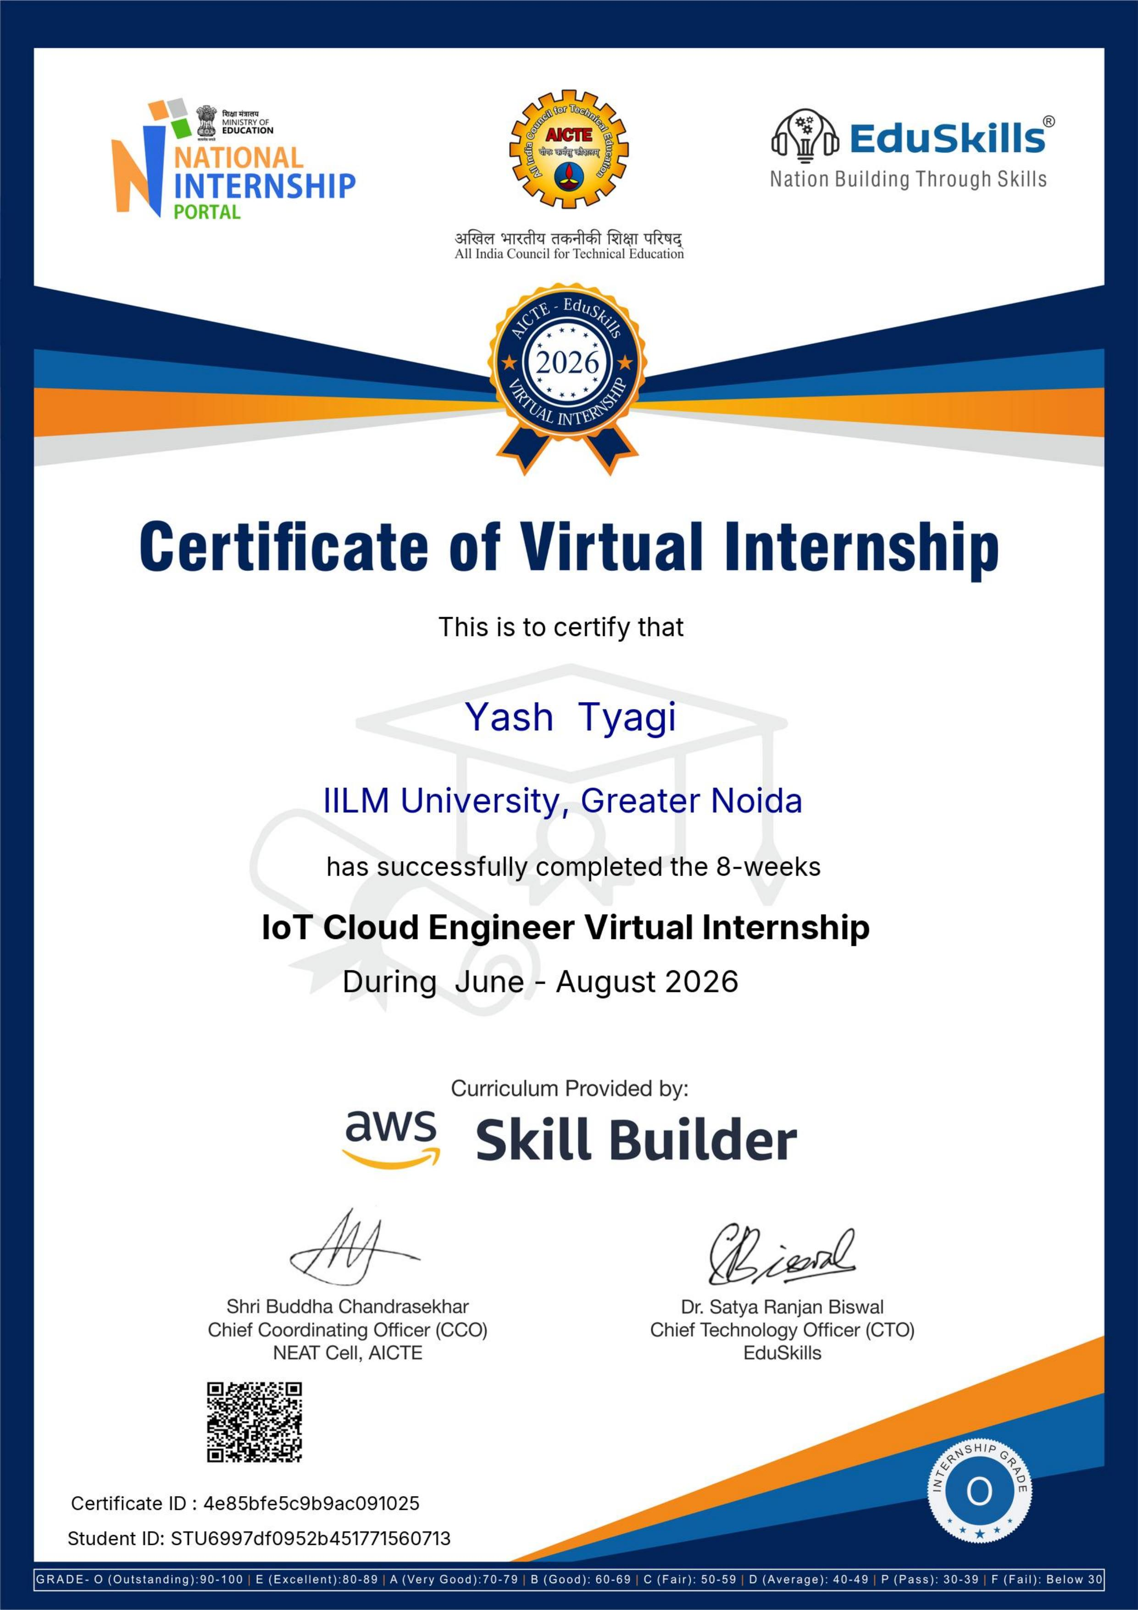
CERTIFICATION
Certificate of Completion
Yash Tyagi successfully completed the 8-week IoT Cloud Engineer Virtual Internship with an Outstanding (Grade O) performance.
IILM UNIVERSITY, GREATER NOIDA
13

Slide 14
THANK YOU
Yash Tyagi
IoT Cloud Engineer Virtual Internship — an 8-week programme completed at IILM University, Greater Noida.
GREATER NOIDA
Roll No. 2410030590 • B.Tech CSE, 5th Semester

